Slide 1
Project 2
Decision Trees and Regression
Paritosh Goel, Lei Shi

Slide 2
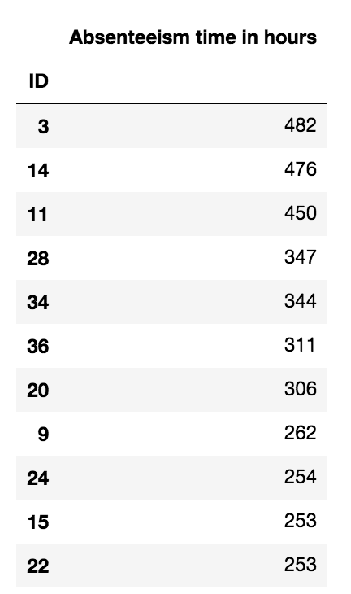
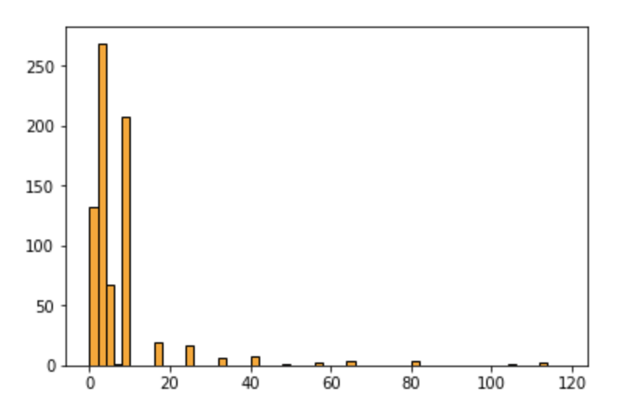
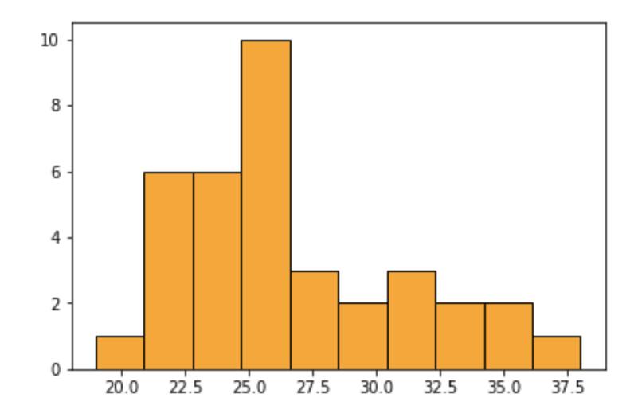
Data Exploration
Body mass index
Absenteeism time in hours

Slide 3
Data Pre-process
Remove “ID” predictor
Remove “Height” and “Weight”
Remove the records with missing values - 0 values in Months , Reasons of Absence/Absenteeism
For classification, discrete “Absenteeism time in hours” into 6 equal-frequency bins
Randomly select 80% data for training and 20% data for testing (in Python)

Slide 4
Classification with Weka
Increased the Min number of objects - to reduce the size of tree and overfitting
No of leaves = 42 , Size of the tree : 54
Some useful information :
1. Reason for Absence = Neoplasm/Diseases of the circulatory system results to maximum hours of Absenteeism (Node: 2.0 -> (12-inf)
People with lesser hit target tend to be more absent
People with less workload and high transport expense, tend to me more absent.
Accuracy - 49.4595 %
Key Points noticed - Minimum number of objects is important factor to reduce the complexity

Slide 5
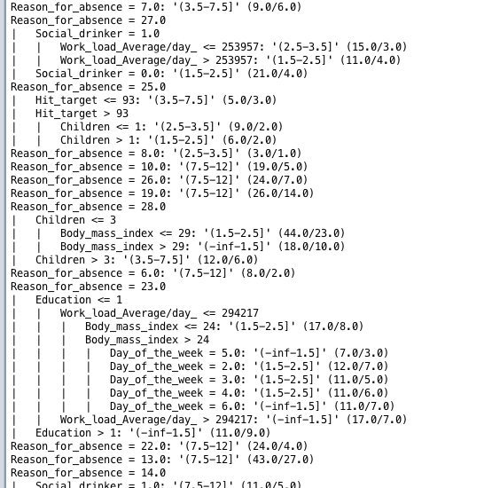

Slide 6
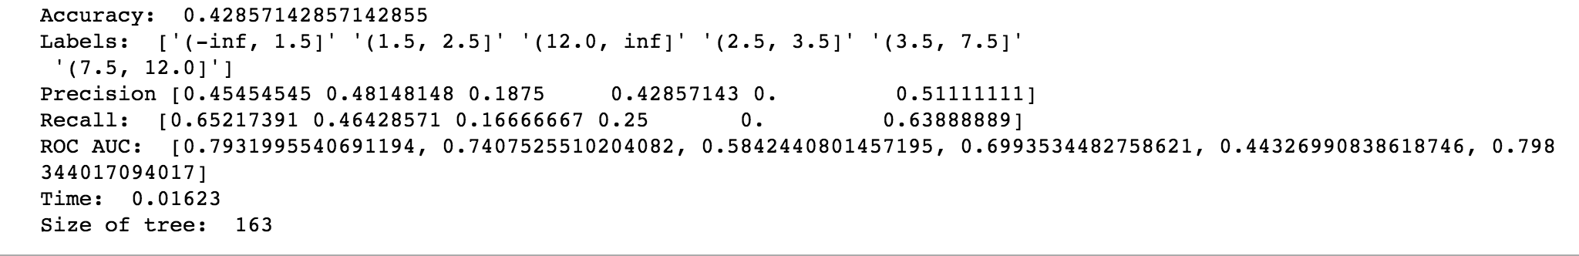
Classification with Python
Best model in Python:
Discrete continuous predictors into 6 equal-frequency bins
Select 10 predictors using SelectKBest function from sklearn package
Pre-pruning: minimum number of samples in a node to split is 10

Slide 7
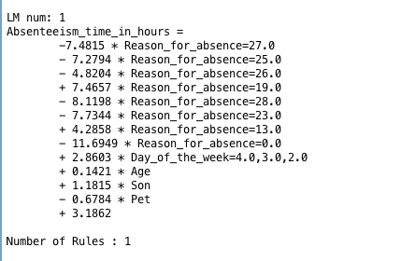
Regression with Weka
Regression without tree --

Slide 8
2. Regression Tree (Some observations)
Unpruned - Size very large with 229 rules (Difficult to extract information)
Its better to leave Nominal to Binarization task to M5P, otherwise the number of attributes become large
All pruned trees didn’t consider any other attribute other than Reason Of Absence

Slide 9
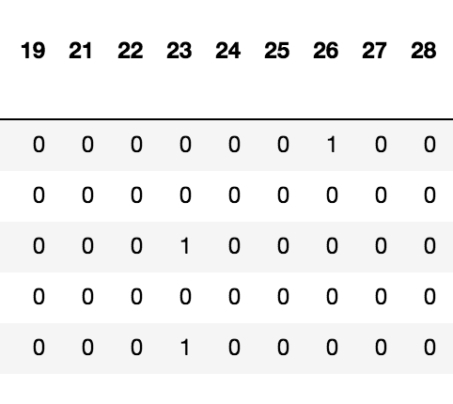
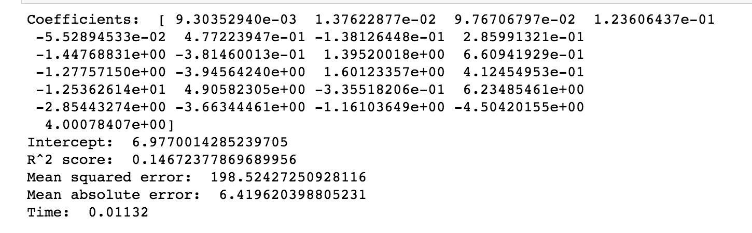
Regression with Python
In Python:
Encode “Reason for absence” using get_dummies function from pandas package.
Best Model: PCA with 25 components

Slide 10
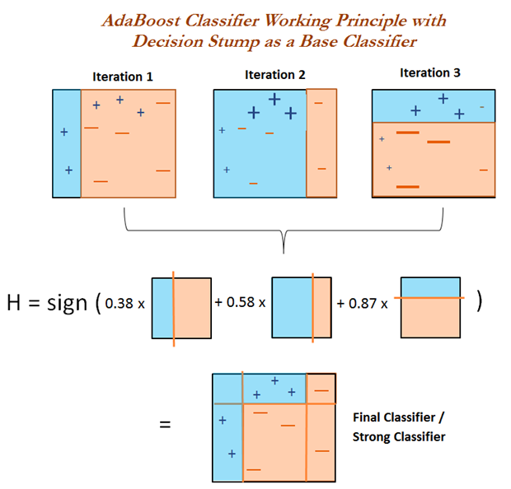
AdaBoost Classifier
AdaBoost is an ensemble method that creates a strong classifier from a number of weak classifiers.
When training each classifier:
Weight data point
Weight classifier
Misclassified data point has larger weight
Classifier with higher accuracy has larger weight
Source: https://www.packtpub.com/mapt/book/big_data_and_business_intelligence/9781788295758/4/ch04lvl1sec32/adaboost-classifier

Slide 11
Thank You!

